Slide 1

Object Oriented Software Engineering
UML
Lecture 1

Slide 2

Today’s Outline:
Introduction to UML

Slide 3
OBJECTIVES
To understand the need of models.
To know what is UML.
To know the features of UML.
To understand the need for UML.
To know what UML is not.

Slide 4
INTRODUCTION
Models are representations of reality which help simplify the reality. It is not different in the software development field. The software under development can be complex. So the models of software can be used. One such modeling technique is the Unified Modeling Language.

Slide 5
WHY MODELS?
Models are created to represent reality in a simplified way. They provide a structure for problem solving. They help in understanding how one can proceed with the problem at hand. They also allow to experiment with multiple solutions. Since the models are created before the actual development of the system, we can understand different possibilities, problems, options etc. This also leads to decrease in the development costs. Since the time will not be wasted in trials and errors the product will be ready in lesser time. Models also help manage the complexity of the problem so the planning of the development, allocation of the resources like machines, programmers, testers can be done easily. When models are created, a number of views of the system are described. The different views give different perspectives of the system.

Slide 6
For example,
The car dashboard and its features interest the car driver. He needs to know which button to press to switch on the inner lights and so on. But the electronics person is not concerned about the dashboard in a similar way. He is interested in the circuitry behind the dashboard. He wants to know which buttons to connect to which instruments, gadgets so that when the button is pressed on the dashboard the driver gets the expected operation. The design person is interested in the look and feel of the dashboard but not all concerned with what goes on behind the panel. Thus everybody looks at the same object but from different perspectives.

Slide 7
Example cont…
Each view has information that is unique to that view. Each view has the information that appears in other views. The information that appears in more than one view is consistent. This information has to be consistent because we are creating views of the same system. This leads to the need for a variety of views depicted in a variety of diagrams.

Slide 8
Introduction
Introduction to UML
The UML stands for Unified modeling language, is a standardized general-purpose visual modeling language in the field of Software Engineering. It is used for specifying, visualizing, constructing, and documenting the primary artifacts of the software system. It helps in designing and characterizing, especially those software systems that incorporate the concept of Object orientation. It describes the working of both the software and hardware systems.

Slide 9
Introduction
The UML was developed in 1994-95 by Grady Booch, Ivar Jacobson, and James Rumbaugh at the Rational Software. In 1997, it got adopted as a standard by the Object Management Group (OMG).
The Object Management Group (OMG) is an association of several companies that controls the open standard UML. The OMG was established to build an open standard that mainly supports the interoperability of object-oriented systems. It is not restricted within the boundaries, but it can also be utilized for modeling the non-software systems. The OMG is best recognized for the Common Object Request Broker Architecture (CORBA) standards.

Slide 10
The Object Management Group gives the formal definition of the UML as
The UML is a graphical language for specifying, visualizing, constructing and documenting the artifacts of the software system.
Specifying – UML provides the means to model precisely, unambiguously and completely the system in question.
Visualizing – UML provides graphical notation which articulates and ambiguously communicates the overall view of the system.
Constructing - UML provides the ‘design’ dimension to the models built. These are language independent and can be implemented in any programming language.
Documenting – every software project involves a lot of documentation from the inception phase to the deliverables.

Slide 11
Goals of UML
Since it is a general-purpose modeling language, it can be utilized by all the modelers.
UML came into existence after the introduction of object-oriented concepts to systemize and consolidate the object-oriented development, due to the absence of standard methods at that time.
The UML diagrams are made for business users, developers, ordinary people, or anyone who is looking forward to understand the system, such that the system can be software or non-software.
Thus it can be concluded that the UML is a simple modeling approach that is used to model all the practical systems.

Slide 12
Characteristics of UML
The UML has the following features:
It is a generalized modeling language.
It is distinct from other programming languages like C++, Python, etc.
It is interrelated to object-oriented analysis and design.
It is used to visualize the workflow of the system.
It is a pictorial language, used to generate powerful modeling artifacts.

Slide 13
FEATURES OF UML
The UML has the following features:
Syntax only – the UML is a language. It tells what model elements are available with different diagrams and how to use them.
Comprehensive – it can be used to model anything even though the modeling syntax aimed primarily at creating models of software-based systems.
13 diagrams – there are 13 different diagrams provided which help model different perspectives of the system. It is not necessary to use all of them in practice but they are there to be used.
Language-independent – it has no bindings to any high-level language. The tool which will be used can do the necessary bindings with the chosen language. The same set of models can be used to develop systems in several languages.

Slide 14
FEATURES OF UML
Process independent – it has no binding with the process by which the models are created. Any process can be used for creating models.
Tool-independent – there are restrictions on the vendors who provide the tools for drawing UML diagrams. Each vendor can do value addition to the visual modeling of the diagrams.
Well documented – the documentation for UML diagrams is available. The UML notation guide is readily available which gives the details of the notation used as well as example using the notation.

Slide 15
NEED FOR UML
The UML is a modeling language and not a notation system. Since it is a language it has predefined structure as well as a repository for the different notations used in it. In English language, when a sentence is written, it has a fixed structure. “I have a book” cannot be written as “A book have I” or “Have a book I”.

Slide 16
WHAT UML IS NOT
UML is not a notation, but it is a language.
• UML is not owned by anyone. It is open to be used by anyone who wishes to use it. It is not proprietary.
• UML is not process or a method. UML encourages the use of object-oriented techniques and iterative software development lifecycles.
• UML is not difficult. It is large, but one need not know it entirely. Also there is no need to use or understand every small thing in it.
• UML is not time consuming. If properly used, use of UML cuts down the development costs. At the same time it gives the advantage of easy understanding and communication, increased productivity and better quality.
• UML is not limited. It is flexible enough to allow newer vocabulary (concepts, words and terms), properties (additional information about the words) and semantics (language rules) which are required for a specific domain.

Slide 17
2. Review of Object Orientation
2.0 Objectives
2.1 Introduction
2.2 Object
2.3 Class
2.4 Encapsulation
2.5 Abstraction
2.6 Inheritance
2.7 Polymorphism
2.7.1 Function Polymorphism
2.7.2 Operator Polymorphism
2.8 Message Passing
2.9 Summary

Slide 18
2.0 OBJECTIVES
To revise the following object oriented concepts –
Objects
Classes
Encapsulation
Abstraction
Inheritance
Polymorphism
Message passing

Slide 19
2.1 Introduction
The UML can be used in a better way with the object oriented technologies. So there is a need to revise the object concepts.

Slide 20
2.2 OBJECT
Every day we come across many things. The things can be a tangible thing like a car or a printer, a role like an employee or a boss, an incident like a flight or an overflow, interaction like contract or a sale or a specification like a color or a shape. Each of these things has some kind of identity, state and behavior.
The identity is the property of an object that distinguishes it from other objects like myCar, yourCar.

Slide 21
2.2 OBJECT
The state describes the data stored in that object like for a car we can specify the brand name as Tata, the model name as Nano, the color as yellow for myCar and the brand name Hyundai, the model name as i10, the color as red for yourCar and so on. The state or the structure is described by the properties or the attributes.
The behavior describes the operations the object carries out like start a car, stop a car, change gear, accelerate, and apply brake. The behavior is described by the operations or the methods.

Slide 22
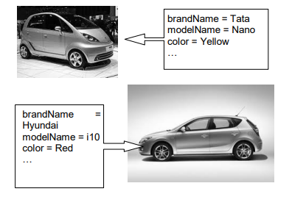
Example
All the cars have a brand name, a model name, a color and so on. All the cars can be started, stopped, accelerated. All the features that describe the state and the behavior of cars are similar. So we need not define them separately.

Slide 23
2.3 CLASS
There can be a large number of cars. We need not define each of them separately. Instead we can describe them together by grouping all the cars under a pattern, template or blueprint. This pattern is known as a class. It creates a group of structurally identical items. e.g. car. A car can have attributes like a brand name, a model name, a color. A car can have operations like to stop, to start, to accelerate, to change gear. A class consists of both a pattern and a mechanism for creating items based on that pattern. The items created or manufactured using the class are called instances. e.g. myCar, yourCar.

Slide 24
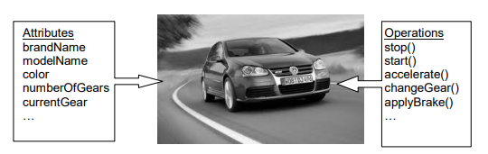
Example

Slide 25
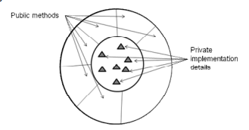
2.4 ENCAPSULATION
The wrapping of data and functions into a single unit called a class is known as encapsulation. The data is not directly accessible to the outside world. Only the operations or functions or methods wrapped in the class can access it. This gives protection and security to the data. The data is insulated from direct access. This achieves a way to hide information or data.

Slide 26
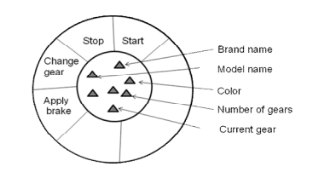
Example
For the car class the following diagram shows the encapsulation where the operations are around the attributes. The attributes are not directly visible or open to the outside. The operations above them form an insulating cover or wrapper around them.

Slide 27
2.5 ABSTRACTION
Abstraction is the act of representing the essential features without including the background details or explanations. This is a fundamental principle of modeling. A system model is created at different levels, starting at the higher level and adding more levels are more and more details become known about the system. A model can be viewed at several levels, each giving different details about the system. So abstraction is looking only at the information that is relevant at the time by hiding details so that there is no confusion in understanding the system

Slide 28
For example
A car is an abstraction which represents the features i.e. the attributes like brandName and modelName and the operations like start and change gear. Also a car represents all possible models of all possible cars

Slide 29
2.6 INHERITANCE
The process by which objects of one class acquire the properties of objects of another class is known as inheritance. This supports hierarchical classification. This provides reusability. It makes it possible to add additional features to an existing class without modifying it. This helps avoid duplication. A class known as the subclass or the child class can inherit attributes and operations from another class known as the superclass or the parent class. The subclass provides the specialized behavior whereas the superclass provides the generalized behavior.

Slide 30
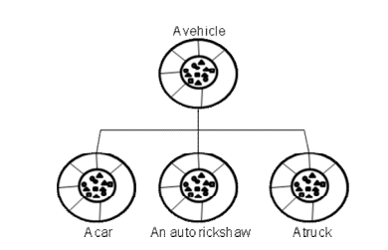
For example
A car is a vehicle. An auto rickshaw is a vehicle. A truck is a vehicle. The superclass is vehicle. The subclasses are car, auto rickshaw, truck

Slide 31
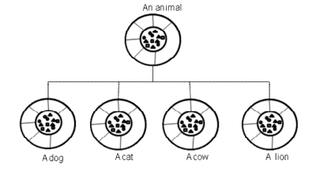
For example
A dog is an animal. A cat is an animal. A cow is an animal. A lion is an animal. The superclass is animal. The subclasses are dog, cat, cow, and lion

Slide 32
2.7 POLYMORPHISM
Polymorphism means the ability to take more than one form. The polymorphism is of two types:
2.7.1 Function polymorphism:
An operation may exhibit different behavior in different instances depending upon the data used in the operation. Here a single name is used to perform different tasks. The same method used in a superclass can be overridden in subclasses to give a different functionality.

Slide 33
For example,
All animals make some kind of a sound. But the sounds of different animals are termed differently. A cat mews. A dog barks. A lion roars.
All polygons occupy area. A triangle, a rectangle, a square are all polygons. The superclass polygon has a method getArea(). For getArea() in subclass triangle the calculation is done by the formula ½ of the product of the base and height. For getArea() in subclass rectangle the calculation is done by the formula product of the length and breadth.

Slide 34
2.7 POLYMORPHISM
2.7.2 Operator polymorphism
This is the process of making an operator to exhibit different behaviors in different instances.
For example,
‘+’ operator when used with integers, it gives the result as the addition of the two integers. We might wish ‘+’ to add two matrices or two vectors.

Slide 35
2.8 MESSAGE PASSING
A message is a request for execution of a procedure that invokes a function in the receiving object that generates the desired result. Message passing achieves communication between a set of objects with each other. This communication is established by sending and receiving information. This can be achieved by specifying the name of the object, the name of the function (message) and the information to be sent.

Slide 36
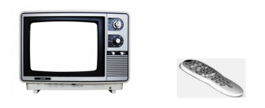
For example
A television may be operated by a remote. When the ON button on the remote is pressed; the television should get switched on. Similarly when the OFF button on the remote is pressed; the television should get switched off. The volume increase/decrease button on the remote is pressed; similar action should be activated by the television. For this the object ‘remote’ invokes the function of the object ‘television’.

Slide 37
Conceptual Modeling
Before moving ahead with the concept of UML, we should first understand the basics of the conceptual model.
A conceptual model is composed of several interrelated concepts. It makes it easy to understand the objects and how they interact with each other. This is the first step before drawing UML diagrams.
Following are some object-oriented concepts that are needed to begin with UML:
Object: An object is a real world entity. There are many objects present within a single system. It is a fundamental building block of UML.
Class: A class is a software blueprint for objects, which means that it defines the variables and methods common to all the objects of a particular type.
Abstraction: Abstraction is the process of portraying the essential characteristics of an object to the users while hiding the irrelevant information. Basically, it is used to envision the functioning of an object.
Inheritance: Inheritance is the process of deriving a new class from the existing ones.
Polymorphism: It is a mechanism of representing objects having multiple forms used for different purposes.
Encapsulation: It binds the data and the object together as a single unit, enabling tight coupling between them.

Slide 38
OO Analysis and Design
OO is an analysis of objects, and design means combining those identified objects. So, the main purpose of OO analysis is identifying the objects for designing a system. The analysis can also be done for an existing system. The analysis can be more efficient if we can identify the objects. Once we have identified the objects, their relationships are then identified, and the design is also produced.
The purpose of OO is given below:
To identify the objects of a system.
To identify their relationships.
To make a design that is executable when the concepts of OO are employed.

Slide 39
OO Analysis and Design
Step 1: OO Analysis
The main purpose of OO analysis is identifying the objects and describing them correctly. After the objects are identified, the designing step is easily carried out. It is a must to identify the objects with responsibilities. Here the responsibility refers to the functions performed by the objects. Each individual object has its own functions to perform. The purpose of the system is fulfilled by collaborating these responsibilities.
Step 2: OO Design
This phase mainly emphasizes on meeting the requirements. In this phase, the objects are joined together as per the intended associations. After the association is completed, the designing phase also gets complete.
This is the last phase that comes after the designing is done. It implements the design using any OO languages like C++, Java, etc.

Slide 40
Role of UML in OO design
As the UML is a modeling language used to model software as well as non-software systems, but here it focuses on modeling OO software applications. It is essential to understand the relation between the OO design and UML. The OO design can be converted into the UML as and when required. The OO languages influence the programming world as they model real world objects.
The UML itself is an amalgamation of object-oriented notations like Object-Oriented Design (OOD), Object Modeling Technique (OMT), and Object-Oriented Software Engineering (OOSE). The strength of these three approaches is utilized by the UML to represent more consistency.

Slide 41
UML Aspects
UML is linked with object oriented design and analysis. UML makes the use of elements and forms associations between them to form diagrams. Diagrams in UML can be broadly classified as:
Structural Diagrams – Capture static aspects or structure of a system. Structural Diagrams include: Component Diagrams, Object Diagrams, Class Diagrams and Deployment Diagrams.
Behavior Diagrams – Capture dynamic aspects or behavior of the system. Behavior diagrams include: Use Case Diagrams, State Diagrams, Activity Diagrams and Interaction Diagrams.

Slide 42
Systems, Models and Views
A model is an abstraction describing a subset of a system
A view depicts selected aspects of a model
A notation is a set of graphical or textual rules for depicting views
Views and models of a single system may overlap each other
Examples:
System: Aircraft
Models: Flight simulator, scale model
Views: All blueprints, electrical wiring, fuel system

Slide 43
Systems, Models and Views
Flightsimulator
Blueprints
Aircraft
Electrical
Wiring
Scale Model

Slide 44
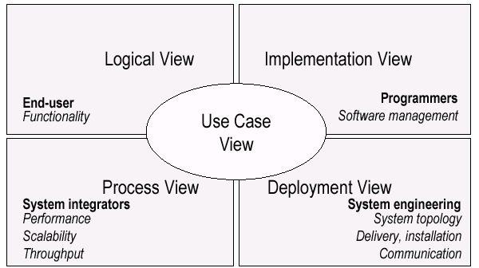
UML Models, Views, Diagrams
UML is a multi-diagrammatic language
Each diagram is a view into a model
Diagram presented from the aspect of a particular stakeholder
Provides a partial representation of the system
Is semantically consistent with other views
Example views

Slide 45
Thank You

